Slide 1
Eliminating viral hepatitis by 2030
Raquel Peck
Chief Executive Officer
World Hepatitis Alliance
uk.linkedin.com/in/raquelpeck/
@RaqPeck

Slide 2
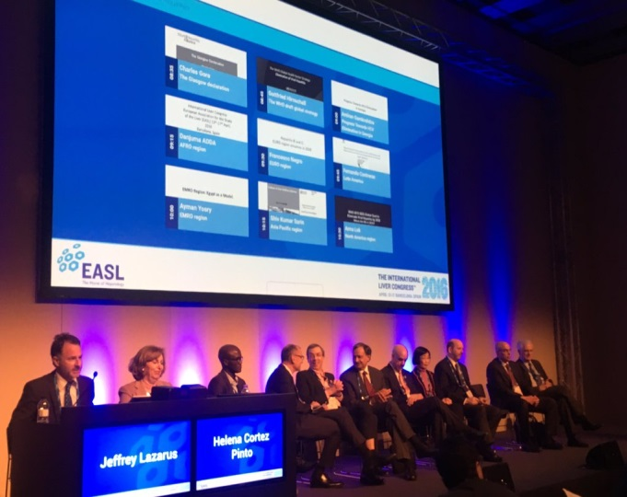
WHA/EASL joint session
Elimination is feasible and achievable by 2030
National plans still a long way off
Unified effort is vital to achieve political will

Slide 3
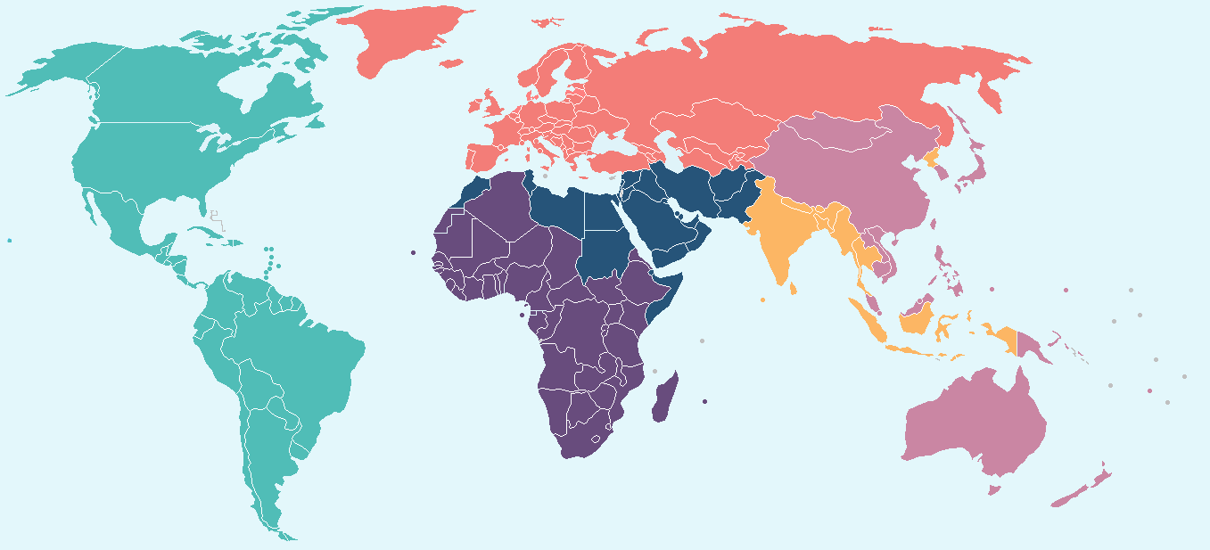
Regional highlights
DAAs not reimbursed/available in many EURO countries
400K people to be treated in Egypt by 2017
Rates of birth dose delivery reducing in USA & Mexico!
20,000 treated in India with DAAs - need to treat 10 million
20,000 treated in India with DAAs - need to treat 10 million
3 countries in Africa have a national hepatitis plan
85% of the #HepC burden in Latin America is in 8 counties

Slide 4
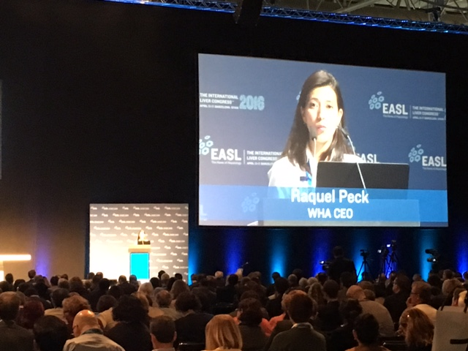
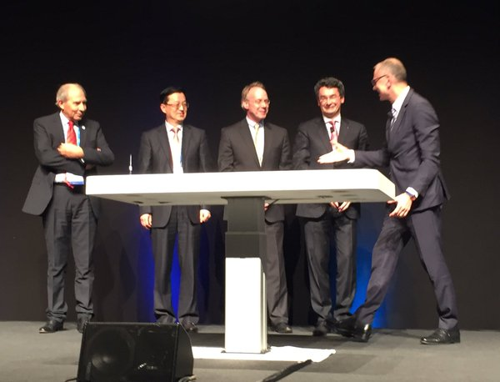
EASL Opening Ceremony
“Finding a common cause like elimination that we can all rally round is vitally important. We have so much to do, there are so many competing priorities for governments that our only hope of gathering the political will that we need is if everyone in hepatitis speaks with one voice.” - Raquel Peck

Slide 5
A movement to eliminate viral hepatitis by 2030
#NOhep

